Slide 1
How to use AWS Cloud Formation Templates by SANTIAGO VILLARREAL

Slide 2
AGENDA
CloudFormation Templates (definition and main concepts)
Best practices
Coding strategies
AWS cli
Demo

Slide 3
Defining a template
You can create templates for architecture of your service or application

Slide 5
WHAT IS A CLOUDFORMATION TEMPLATE
Create and provisions AWS infrastructure
Predictably and repeatedly
Describes your infrastructure
Template file with set of resources together as a single unit (stack).

Slide 6
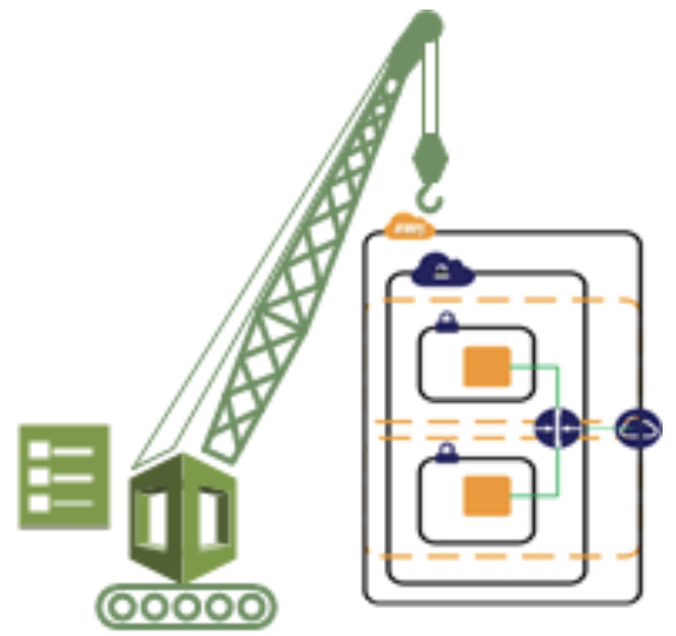
Cloud Formation STACK
AWS CloudFormation makes underlying service calls to AWS to provision and configure all resources

Slide 7
BASIC OPERATIONS
Creates a stack as specified in the template. After the call completes successfully, the stack creation starts
Can't manually recreate a resource, have to remove the resource and any references
Do not show up in the DescribeStacks API if the deletion has been completed successfully

Slide 8

KEY CONCEPT: INFRASTRUCTURE AS CODE

Slide 9
DIFFERENT FORMATS
JSON
{
"AWSTemplateFormatVersion": "2010-09-09",
"Parameters": {
"SubnetID": {
"Type": "AWS::EC2::Subnet::Id",
"Description": "Subnet to deploy EC2 instance into"
},
"SecurityGroupIDs": {
"Type":
...
YAML
AWSTemplateFormatVersion: 2010-09-09
Parameters:
SubnetID:
Type: AWS::EC2::Subnet::Id
Description: Subnet to deploy EC2 instance into
SecurityGroupIDs:
Type: List<AWS::EC2::SecurityGroup::Id>
Description: List of Security Groups to add to EC2 instance
KeyName:
Type: AWS::EC2::KeyPair::KeyName
Description: >-
...

Slide 10
BEST PRACTICES
Take advantage of following concepts

Slide 11
Declare IAM policies and roles

Slide 12
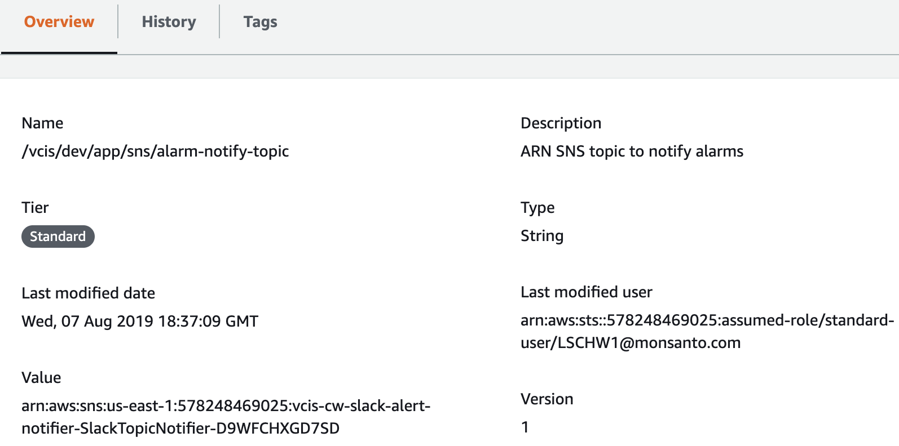
Use SSM parameter store

Slide 13
Tagging

Slide 14
Nested templates
Frontend
Load balancer
Autoscaloing group
Website 1
Nested stack
Amazon RDS
Website 1
Nested stack
Amazon DynamoDB

Slide 15
process is easy
Code
your
infra
Upload
to
S3
Create stack
Wait
CFn provisioning

Slide 16
DIFFERENT CODING
 | CloudFormation | CDK | Terraform
PROS | AWS oficial Native Updates Cross stack reference | AWS oficial Developer-friendly Compact / Cleaner Execution inspect | Open source Too cleaner Inspect plan Modules Support
CONS | Too verbose Repeated code Support Confused CLI | Updates Maturity | Updates Debugging 3rd party

Slide 17
AWS CLI
Launch CFt templates
Parameters
Check status

Slide 18
Let’s see all these stuffs working on!

Slide 19
Thanks!
Any questions?

